Slide 1
Flow of Testing Process

Slide 2
Table of Contents
Login to POWER (Task Management System)
Creating a New Task.
Adding daily progress/comment on Power.
Test Cases Template.
Open Bug Report Template
Closed Bug Report Template
Dead/Impacted Test Cases
Updating Task on Git-Hub.
Attachment Flow.
Summary Report Template.
E-Mail Format for Testing Report summary.
E-Mail Format for Re-Testing Report summary.

Slide 3
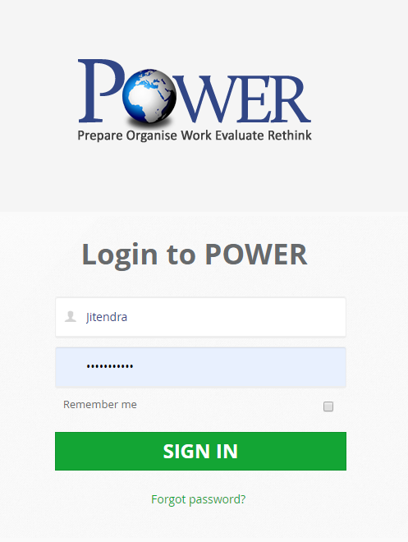
Login to Power
As soon as the task gets assigned, User needs to create a task on POWER-Project management tool.
1. User needs to login to Power by entering login credentials supplied by Techfour team. 2. After clicking on Sign-in button user will get navigated to the Home page of POWER. 3. User can Reset his/her password by clicking on Forgot Password link followed by subsequent steps.

Slide 4
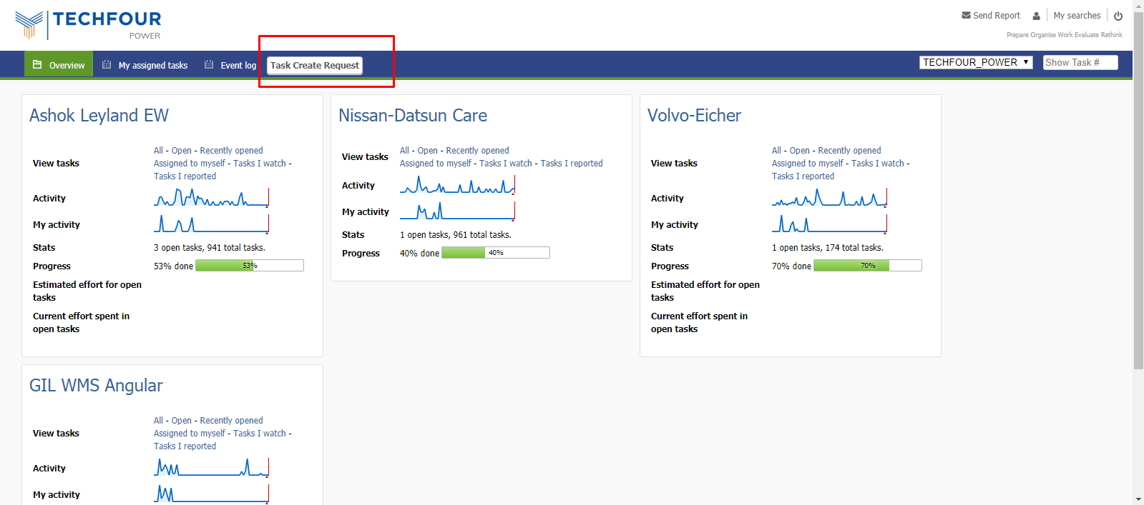
Creating New Task
1.After getting login user will have to create a New Task by clicking on Task Create Request appearing as Menu item.

Slide 5
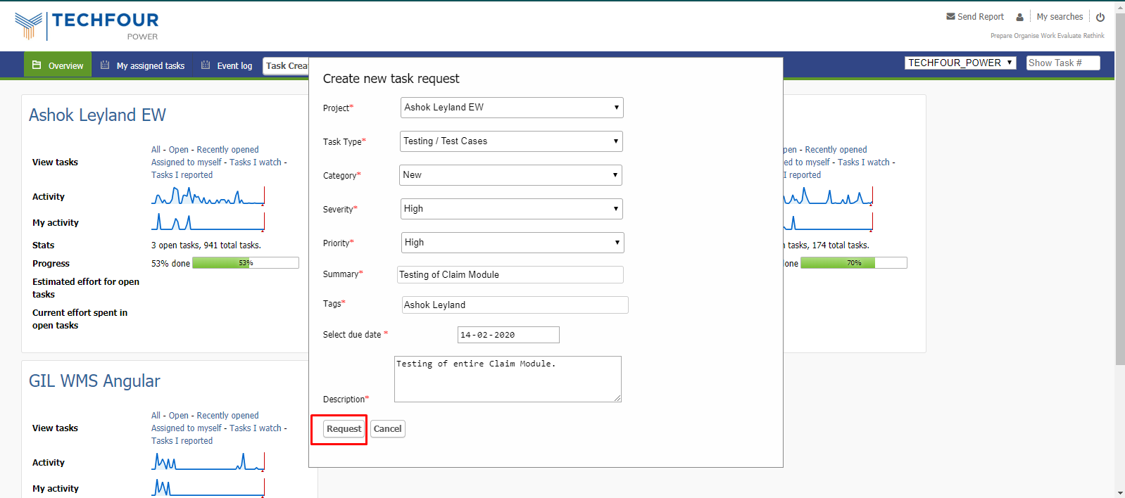
Creating New Task
1.User needs to fill the New Task Request form in order to create a new task request. User have to fill the following fields:
1. Project Name 2. Task Type 3. Category 4. Severity 5. Priority 6. Summery 7. Tags 8. Due Date 9. Description
2. After filling up the form click on Request button to send a request for new task.
Note: User will have to update the task daily after the task gets approved by the Test lead/Project manager.

Slide 6
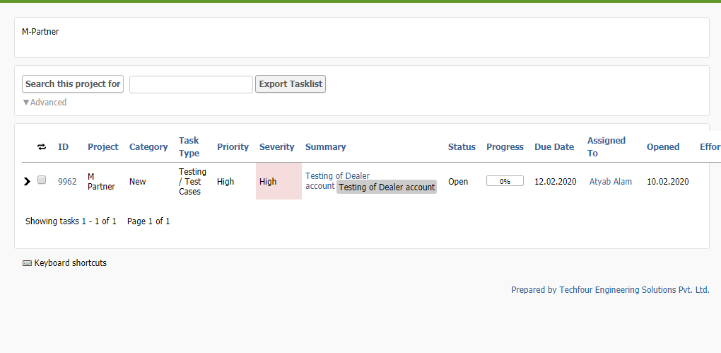
Adding daily progress/comment on Power
1. After the approval of task it will appear under My assigned Task. 2. User needs to click on My assigned Task. List of added task will appear on the page. 3. In order to update the task user needs to click on the Task ID which is to be update.

Slide 7
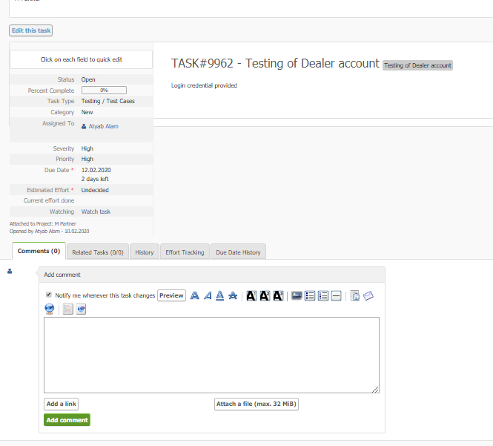
Adding daily progress/comment on Power
1. After clicking on Task ID of selected task User will get navigate to the task page of selected task id. 2. User have to update the Percent complete according to the task completed on a particular day. 3. User needs to update the comment of daily performed task he/she can also attach the supported files. 4. If the entire task is complete then user needs to select the status as “Completed on Production. 5. By clicking on Add Comment , Comment box will get update.

Slide 8
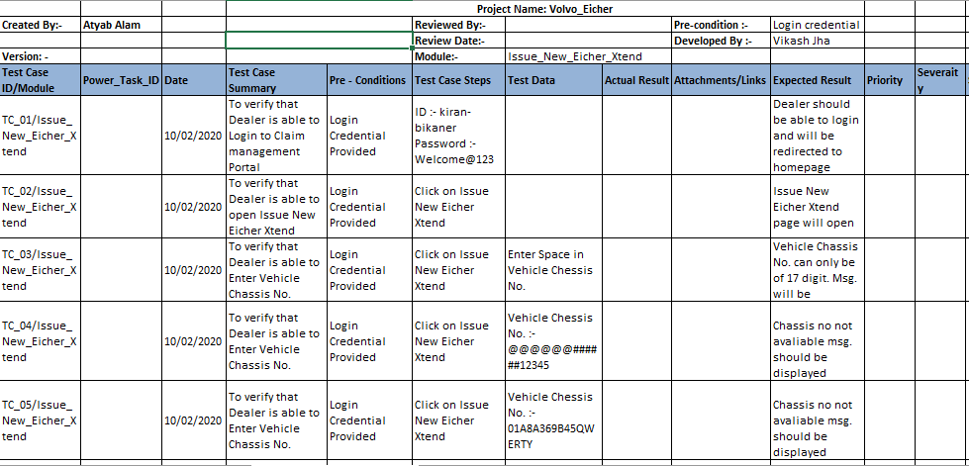
Test Cases Template.
This is the template that we are using for writing test cases module wise that is entire login activity, Password reset etc. Following fields are there for writing test cases: 1. Test Case ID 2. Test Case Summery 3. Pre-Conditions
4. Test Case Steps 5. Test Data 6. Actual Result 7. Attachments/Link 8. Expected Result 9. Priority 10. Severity 11. Status.

Slide 9
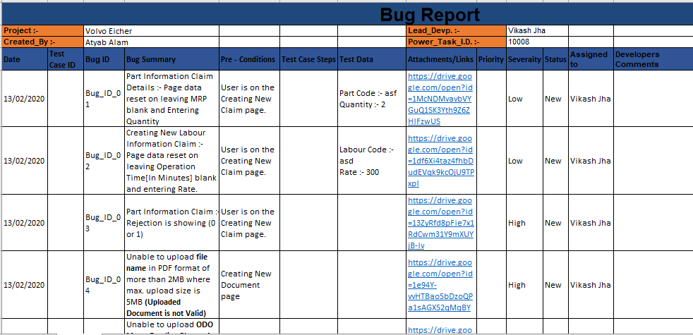
Open Bug Report Template
This is the template that we are using for writing bug report module. Following fields are there for writing test cases: 1. Date 2. Test Case ID 3. Bug ID
4. Task ID 5. Bug Summery 6. Pre-Conditions
7. Steps to Reproduce 8. Test Data 9. Attachments/Link 10. Priority 11. Severity 12. Status. 13. Assigned To 14. Developers Comment 15. Testers Comment 16. Dev. Closing Date 1. Testers Closing Date.

Slide 10
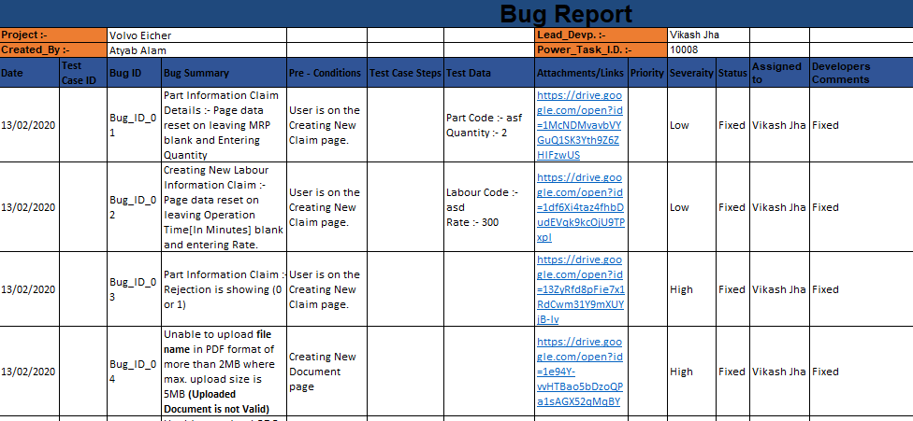
Closed Bug Report Template
This is the template that we are using for writing bug report module. Following fields are there for writing test cases: 1. Date 2. Test Case ID 3. Bug ID
4. Task ID 5. Bug Summery 6. Pre-Conditions
7. Steps to Reproduce 8. Test Data 9. Attachments/Link 10. Priority 11. Severity 12. Status. 13. Assigned To 14. Developers Comment 15. Testers Comment 16. Dev. Closing Date 1. Testers Closing Date.

Slide 11
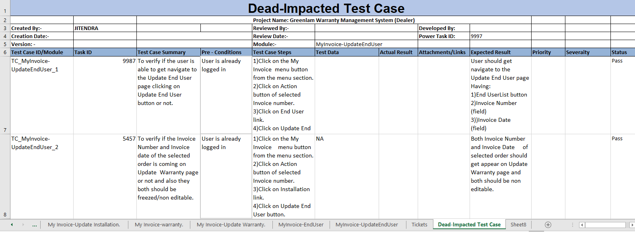
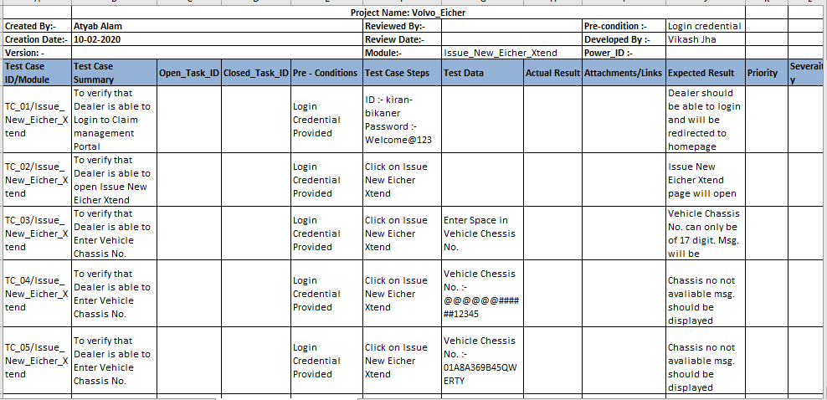
Dead/Impacted Test Cases
The test cases which are no longer in use due to the change in Requirement will be shifted to this sheet which is mapped with the Task ID.
Open Task ID :->> Task ID due to which this Test-Case was Written
Closed Task ID :->> Task ID due to which this Functionality or Module was Removed.

Slide 12
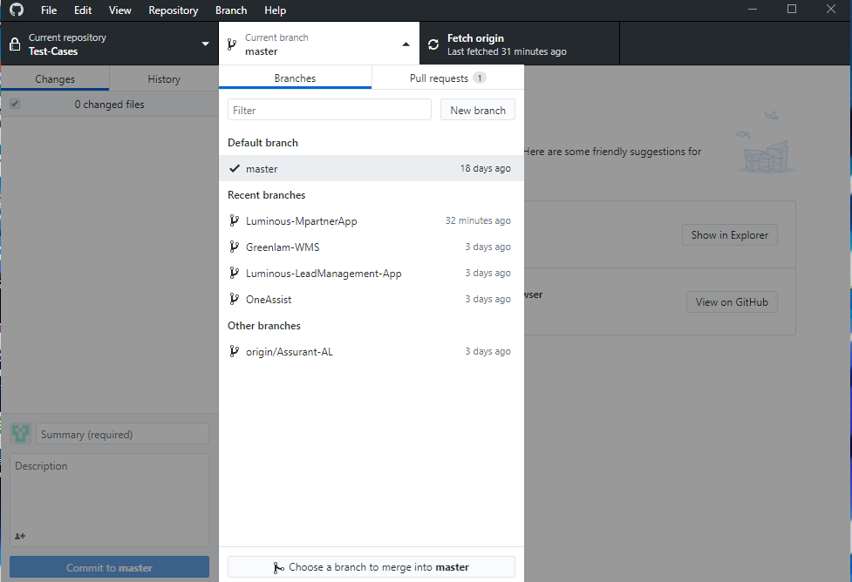
Updating Task on Git-Hub
Download Git-Hub Desktop Application.
Create Git-Hub Account.
Ask project manager to create branch of the project in which we are working.
Go to Current Branch and Select the ongoing project
Go to loctaion which we select to push and fetch our File
Move Test report to that location
Add Summary and Description
Click on push to upload Test report on Git-Hub
If we want to make any change in Test-Case then select the project in the current branch and click on Fetch Origin.
We can see the Test-Case in the source location

Slide 13
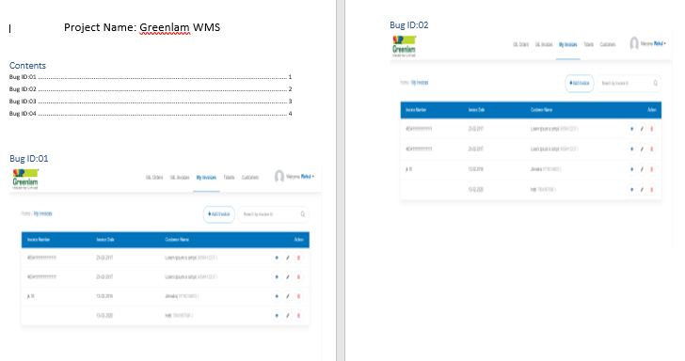
Attachment Flow.
Attachment Flow.
Word File For Attachment
After completing Bug-Report we will start making Attachment file.
Attachment will be arranged according to Bug-ID.
In Table of content we will use hyper-link so that it is easy to find related Attachment.

Slide 14
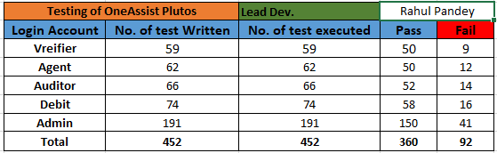
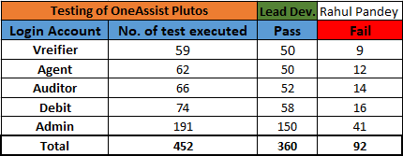
Summary Report Template
Testing Repot Summary format.
Re-Testing Report summary format.

Slide 15
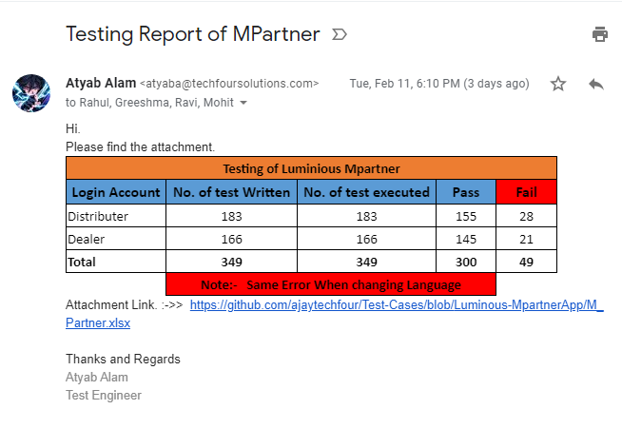
E-Mail Format for Testing Report summary.
Tester need to send E-Mail in this format as soon as he/she will complete his/her task.

Slide 16
E-Mail Format for Re-Testing Report summary.
Tester need to send E-Mail in this format as soon as he/she will complete his/her Re-Testing task.

Slide 17


